Slide 1

One-Sample Tests of Hypothesis
Chapter 10
McGraw-Hill/Irwin
Copyright © 2012 by The McGraw-Hill Companies, Inc. All rights reserved.

Slide 2
Learning Objectives
LO1 Define a hypothesis.
LO2 Explain the five-step hypothesis-testing procedure.
LO3 Describe Type I and Type II errors.
LO4 Define the term test statistic and explain how it is used.
LO5 Distinguish between a one-tailed and two-tailed hypothesis
LO6 Conduct a test of hypothesis about a population mean.
LO7 Compute and interpret a p-value.
LO8 Conduct a test of hypothesis about a population proportion.
LO9 Compute the probability of a Type II error.
10-<number>

Slide 3

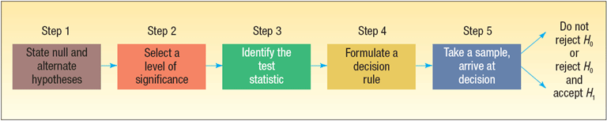
Hypothesis and Hypothesis Testing
LO1 Define a hypothesis.
LO2 Explain the five-step hypothesis-testing procedure.
HYPOTHESIS A statement about the value of a population parameter developed for the purpose of testing.
HYPOTHESIS TESTING A procedure based on sample evidence and probability theory to determine whether the hypothesis is a reasonable statement.
TEST STATISTIC A value, determined from sample information, used to determine whether to reject the null hypothesis.
CRITICAL VALUE The dividing point between the region where the null hypothesis is rejected and the region where it is not rejected.
10-<number>

Slide 4

Important Things to Remember about H₀ and H₁
LO5 Distinguish between a one-tailed and two-tailed hypothesis
H₀: null hypothesis and H₁: alternate hypothesis
H₀ and H₁ are mutually exclusive and collectively exhaustive
H₀ is always presumed to be true
H₁ has the burden of proof
A random sample (n) is used to “reject H₀”
If we conclude 'do not reject H₀', this does not necessarily mean that the null hypothesis is true, it only suggests that there is not sufficient evidence to reject H₀; rejecting the null hypothesis then, suggests that the alternative hypothesis may be true.
Equality is always part of H₀ (e.g. “=” , “≥” , “≤”).
“≠” “<” and “>” always part of H₁
In actual practice, the status quo is set up as H₀
If the claim is “boastful” the claim is set up as H₁ (we apply the Missouri rule – “show me”). Remember, H₁ has the burden of proof
In problem solving, look for key words and convert them into symbols. Some key words include: “improved, better than, as effective as, different from, has changed, etc.”
Keywords | Inequality Symbol | Part of:
Larger (or more) than | > | H₁
Smaller (or less) | < | H₁
No more than | ≤ | H₀
At least | ≥ | H₀
Has increased | > | H₁
Is there difference? | ≠ | H₁
Has not changed | = | H₀
Has “improved”, “is better than”. “is more effective” | See left text | H₁
10-<number>

Slide 5
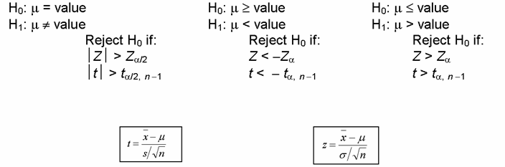
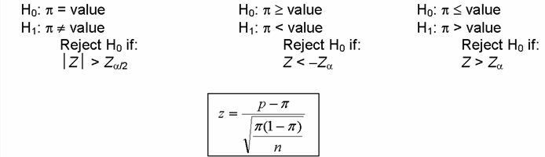
Hypothesis Setups for Testing a Mean (μ) or a Proportion (π)
LO6 Conduct a test of hypothesis about a population mean.
MEAN
PROPORTION
10-<number>

Slide 6

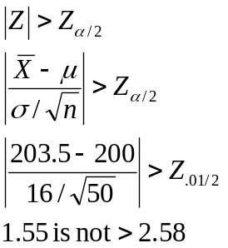
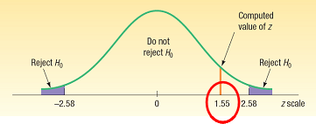
Testing for a Population Mean with a
Known Population Standard Deviation- Example
LO6
EXAMPLE
Jamestown Steel Company manufactures and assembles desks and other office equipment . The weekly production of the Model A325 desk at the Fredonia Plant follows the normal probability distribution with a mean of 200 and a standard deviation of 16. Recently, new production methods have been introduced and new employees hired. The VP of manufacturing would like to investigate whether there has been a change in the weekly production of the Model A325 desk.
Step 4: Formulate the decision rule.
Reject H₀ if |Z| > Z_{α/2}
Step 5: Make a decision and interpret the result.
Because 1.55 does not fall in the rejection region, H₀ is not rejected. We conclude that the population mean is not different from 200. So we would report to the vice president of manufacturing that the sample evidence does not show that the production rate at the plant has changed from 200 per week.
Step 1: State the null hypothesis and the alternate hypothesis.
H₀: μ = 200
H₁: μ ≠ 200
(note: keyword in the problem “has changed”)
Step 2: Select the level of significance.
α = 0.01 as stated in the problem
Step 3: Select the test statistic.
Use Z-distribution since σ is known
10-<number>

Slide 7
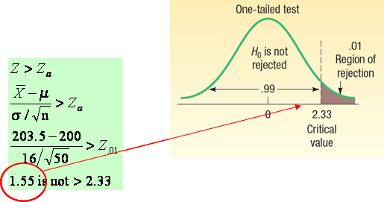
Testing for a Population Mean with a Known Population Standard Deviation- Another Example
LO6
Suppose in the previous problem the vice president wants to know whether there has been an increase in the number of units assembled. To put it another way, can we conclude, because of the improved production methods, that the mean number of desks assembled in the last 50 weeks was more than 200?
Recall: σ=16, n=200, α=.01
Step 1: State the null hypothesis and the alternate hypothesis.
H₀: μ ≤ 200
H₁: μ > 200
(note: keyword in the problem “an increase”)
Step 2: Select the level of significance.
α = 0.01 as stated in the problem
Step 3: Select the test statistic.
Use Z-distribution since σ is known
Step 4: Formulate the decision rule.
Reject H₀ if Z > Z_{α}
Step 5: Make a decision and interpret the result.
Because 1.55 does not fall in the rejection region, H₀ is not rejected. We conclude that the average number of desks assembled in the last 50 weeks is not more than 200
10-<number>

Slide 8
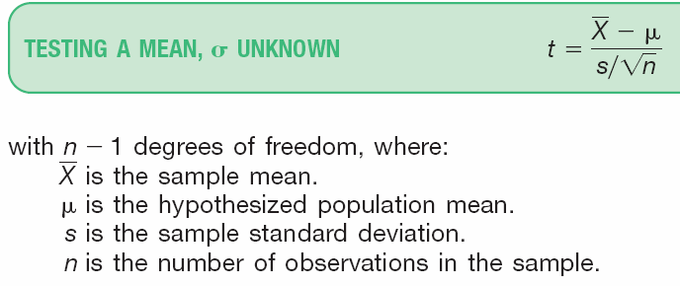
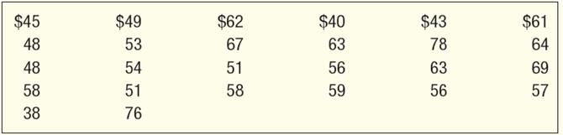
Testing for the Population Mean:
Population Standard Deviation Unknown
LO6
When the population standard deviation (σ) is unknown, the sample standard deviation (s) is used in its place the t-distribution is used as test statistic, which is computed using the formula:
EXAMPLE
The McFarland Insurance Company Claims Department reports the mean cost to process a claim is $60. An industry comparison showed this amount to be larger than most other insurance companies, so the company instituted cost-cutting measures. To evaluate the effect of the cost-cutting measures, the Supervisor of the Claims Department selected a random sample of 26 claims processed last month. The sample information is reported below.
At the .01 significance level is it reasonable a claim is now less than $60?
10-<number>

Slide 9
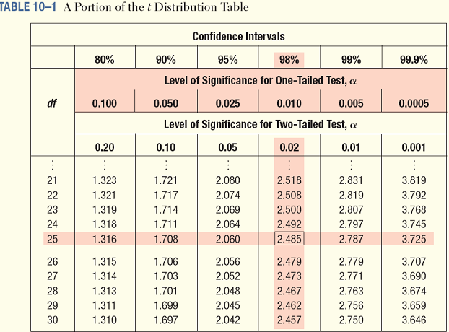
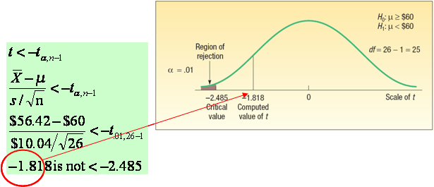
Testing for the Population Mean: Population Standard Deviation Unknown - Example
LO6
Step 1: State the null hypothesis and the alternate hypothesis.
H0: μ ≥ $60
H1: μ < $60
Step 2: Select the level of significance.
α = 0.01 as stated in the problem
Step 3: Select the test statistic.
Use t-distribution since σ is unknown
Step 4: Formulate the decision rule.
Reject H₀ if t < -t_{α,n-1}
Step 5: Make a decision and interpret the result.
Because -1.818 does not fall in the rejection region, H₀ is not rejected at the .01 significance level. We have not demonstrated that the cost-cutting measures reduced the mean cost per claim to less than $60. The difference of $3.58 ($56.42 - $60) between the sample mean and the population mean could be due to sampling error.
10-<number>

Slide 10

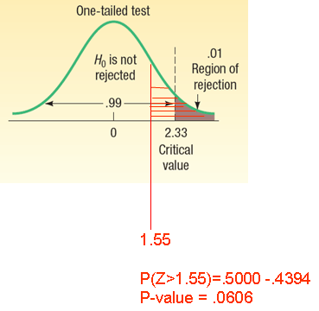
Type of Errors and p-value in Hypothesis Testing
LO7 Compute and interpret a p-value
EXAMPLE p-Value
Recall the last problem where the hypothesis and decision rules were set up as:
H₀: μ ≤ 200
H₁: μ > 200
Reject H₀ if Z > Z_{α}
where Z = 1.55 and Z_{α} =2.33
Reject H₀ if p-value < α
0.0606 is not < 0.01
Conclude: Fail to reject H₀
Type I Error -
  Defined as the probability of rejecting the null hypothesis when it is actually true.
  This is denoted by the Greek letter “α”
  Also known as the significance level of a test
Type II Error:
  Defined as the probability of “accepting” the null hypothesis when it is actually false.
  This is denoted by the Greek letter “β”
p-VALUE is the probability of observing a sample value as extreme as, or more extreme than, the value observed, given that the null hypothesis is true.
In testing a hypothesis, we can also compare the p-value to the significance level (α).
Decision rule using the p-value:
Reject H₀ if p-value < significance level
10-<number>

Slide 11

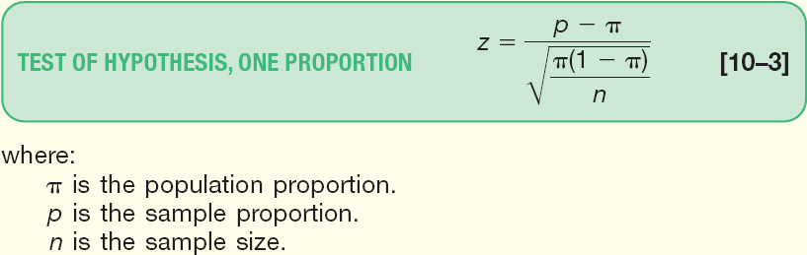
Tests Concerning Proportion using the z-Distribution
LO8 Conduct a test of hypothesis about a population proportion.
A Proportion is the fraction or percentage that indicates the part of the population or sample having a particular trait of interest.
The sample proportion is denoted by p and is found by x/n
It is assumed that the binomial assumptions discussed in Chapter 6 are met:
(1) the sample data collected are the result of counts;
(2) the outcome of an experiment is classified into one of two mutually exclusive categories—a “success” or a “failure”;
(3) the probability of a success is the same for each trial; and (4) the trials are independent
Both nπ and n(1- π ) are at least 5.
When the above conditions are met, the normal distribution can be used as an approximation to the binomial distribution
The test statistic is computed as follows:
10-<number>

Slide 12
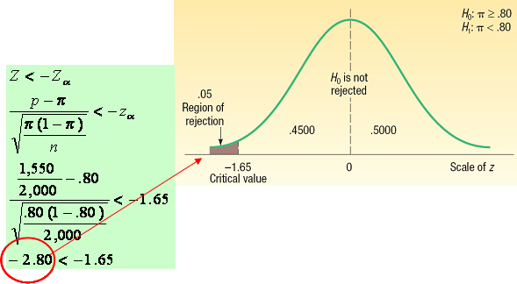
Test Statistic for Testing a Single Population Proportion - Example
LO8
Step 4: Formulate the decision rule.
Reject H₀ if Z < -Z_{α}
Step 5: Make a decision and interpret the result.
The computed value of z (2.80) is in the rejection region, so the null hypothesis is rejected at the .05 level. The evidence at this point does not support the claim that the incumbent governor will return to the governor’s mansion for another four years.
EXAMPLE
Suppose prior elections in a certain state indicated it is necessary for a candidate for governor to receive at least 80 percent of the vote in the northern section of the state to be elected. The incumbent governor is interested in assessing his chances of returning to office and plans to conduct a survey of 2,000 registered voters in the northern section of the state. Using the hypothesis-testing procedure, assess the governor’s chances of reelection.
Step 1: State the null hypothesis and the alternate hypothesis.
H₀: π ≥ .80
H₁: π < .80
(note: keyword in the problem “at least”)
Step 2: Select the level of significance.
α = 0.01 as stated in the problem
Step 3: Select the test statistic.
Use Z-distribution since the assumptions are met and nπ and n(1-π) ≥ 5
10-<number>

Slide 13

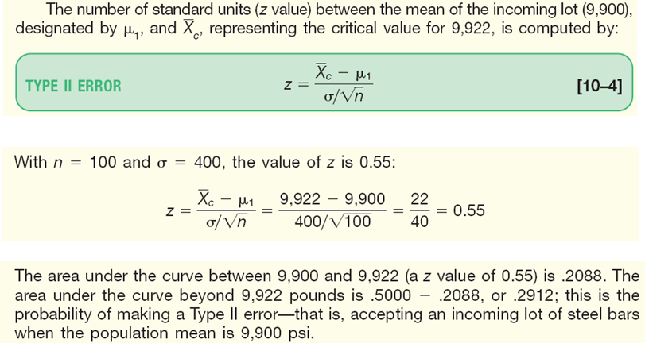
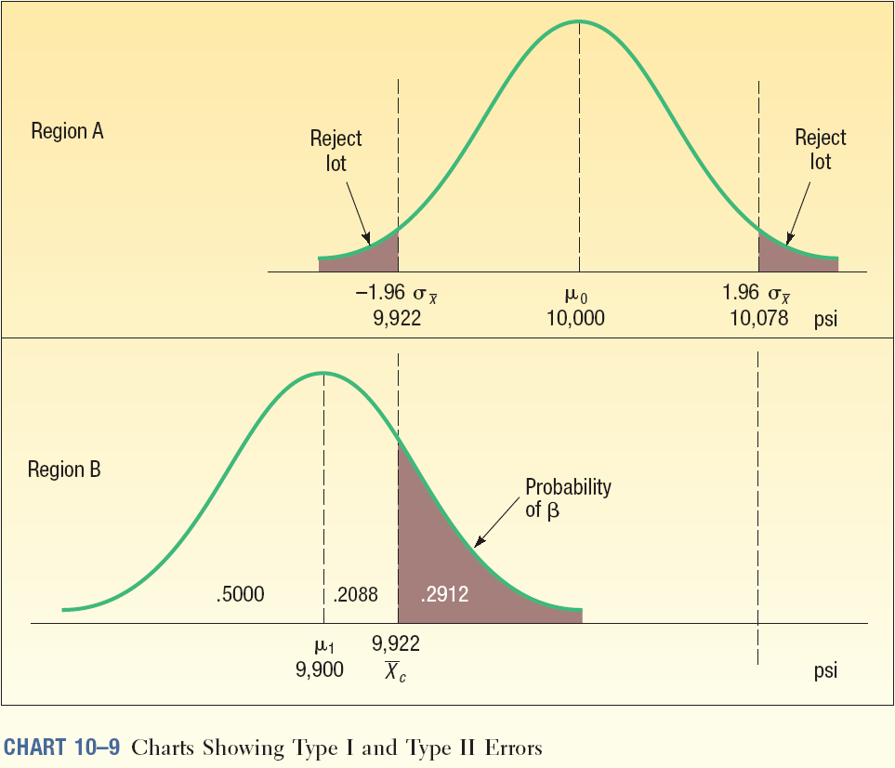
Type II Error
LO9 Compute the probability of a Type II error.
Recall Type I Error, the level of significance, denoted by the Greek letter “α”, is defined as the probability of rejecting the null hypothesis when it is actually true.
Type II Error, denoted by the Greek letter “β”,is defined as the probability of “accepting” the null hypothesis when it is actually false.
EXAMPLE
A manufacturer purchases steel bars to make cotter pins. Past experience indicates that the mean tensile strength of all incoming shipments is 10,000 psi and that the standard deviation, σ, is 400 psi. In order to make a decision about incoming shipments of steel bars, the manufacturer set up this rule for the quality-control inspector to follow: “Take a sample of 100 steel bars. At the .05 significance level if the sample mean strength falls between 9,922 psi and 10,078 psi, accept the lot. Otherwise the lot is to be rejected.”
10-<number>

Slide 14
Type I and Type II Errors Illustrated
LO9
10-<number>

Slide 15
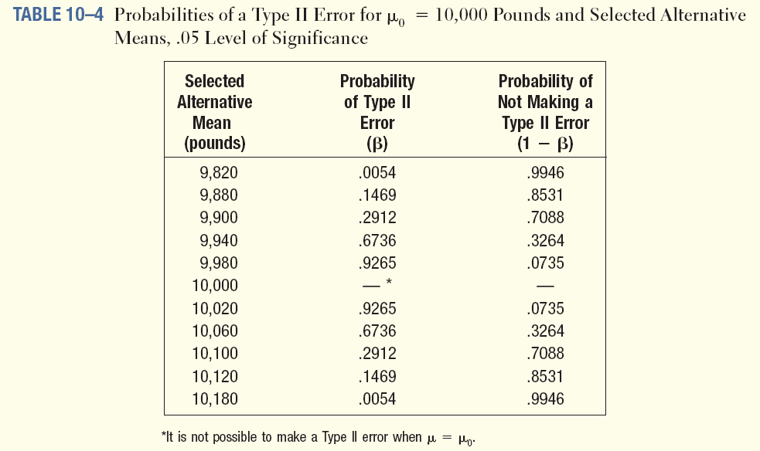
Type II Errors For Varying Mean Levels
LO9
10-<number>

